Slide 1
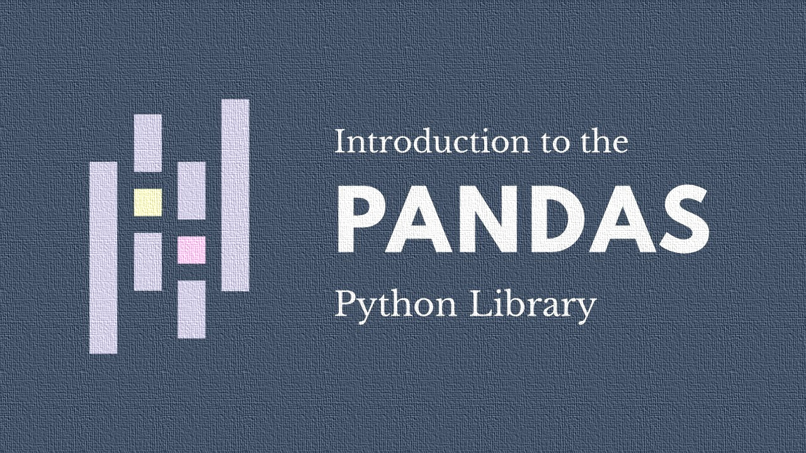
GROUP-13
GROUP MEMBERS- VAIBHAV ANAND
VANSH SINGH
ARYAN JAISWAL
AYUSH SINGH
SHREYANSH SINGH

Slide 2

Mastering Data with Pandas: Your Guide to Data Analysis in Python
This presentation will guide you through the essential functionalities of the Pandas library, a cornerstone for data manipulation and analysis in Python. Whether you're a beginner or looking to deepen your understanding, we'll explore how Pandas empowers you to efficiently process, clean, analyze, and visualize your data.

Slide 3


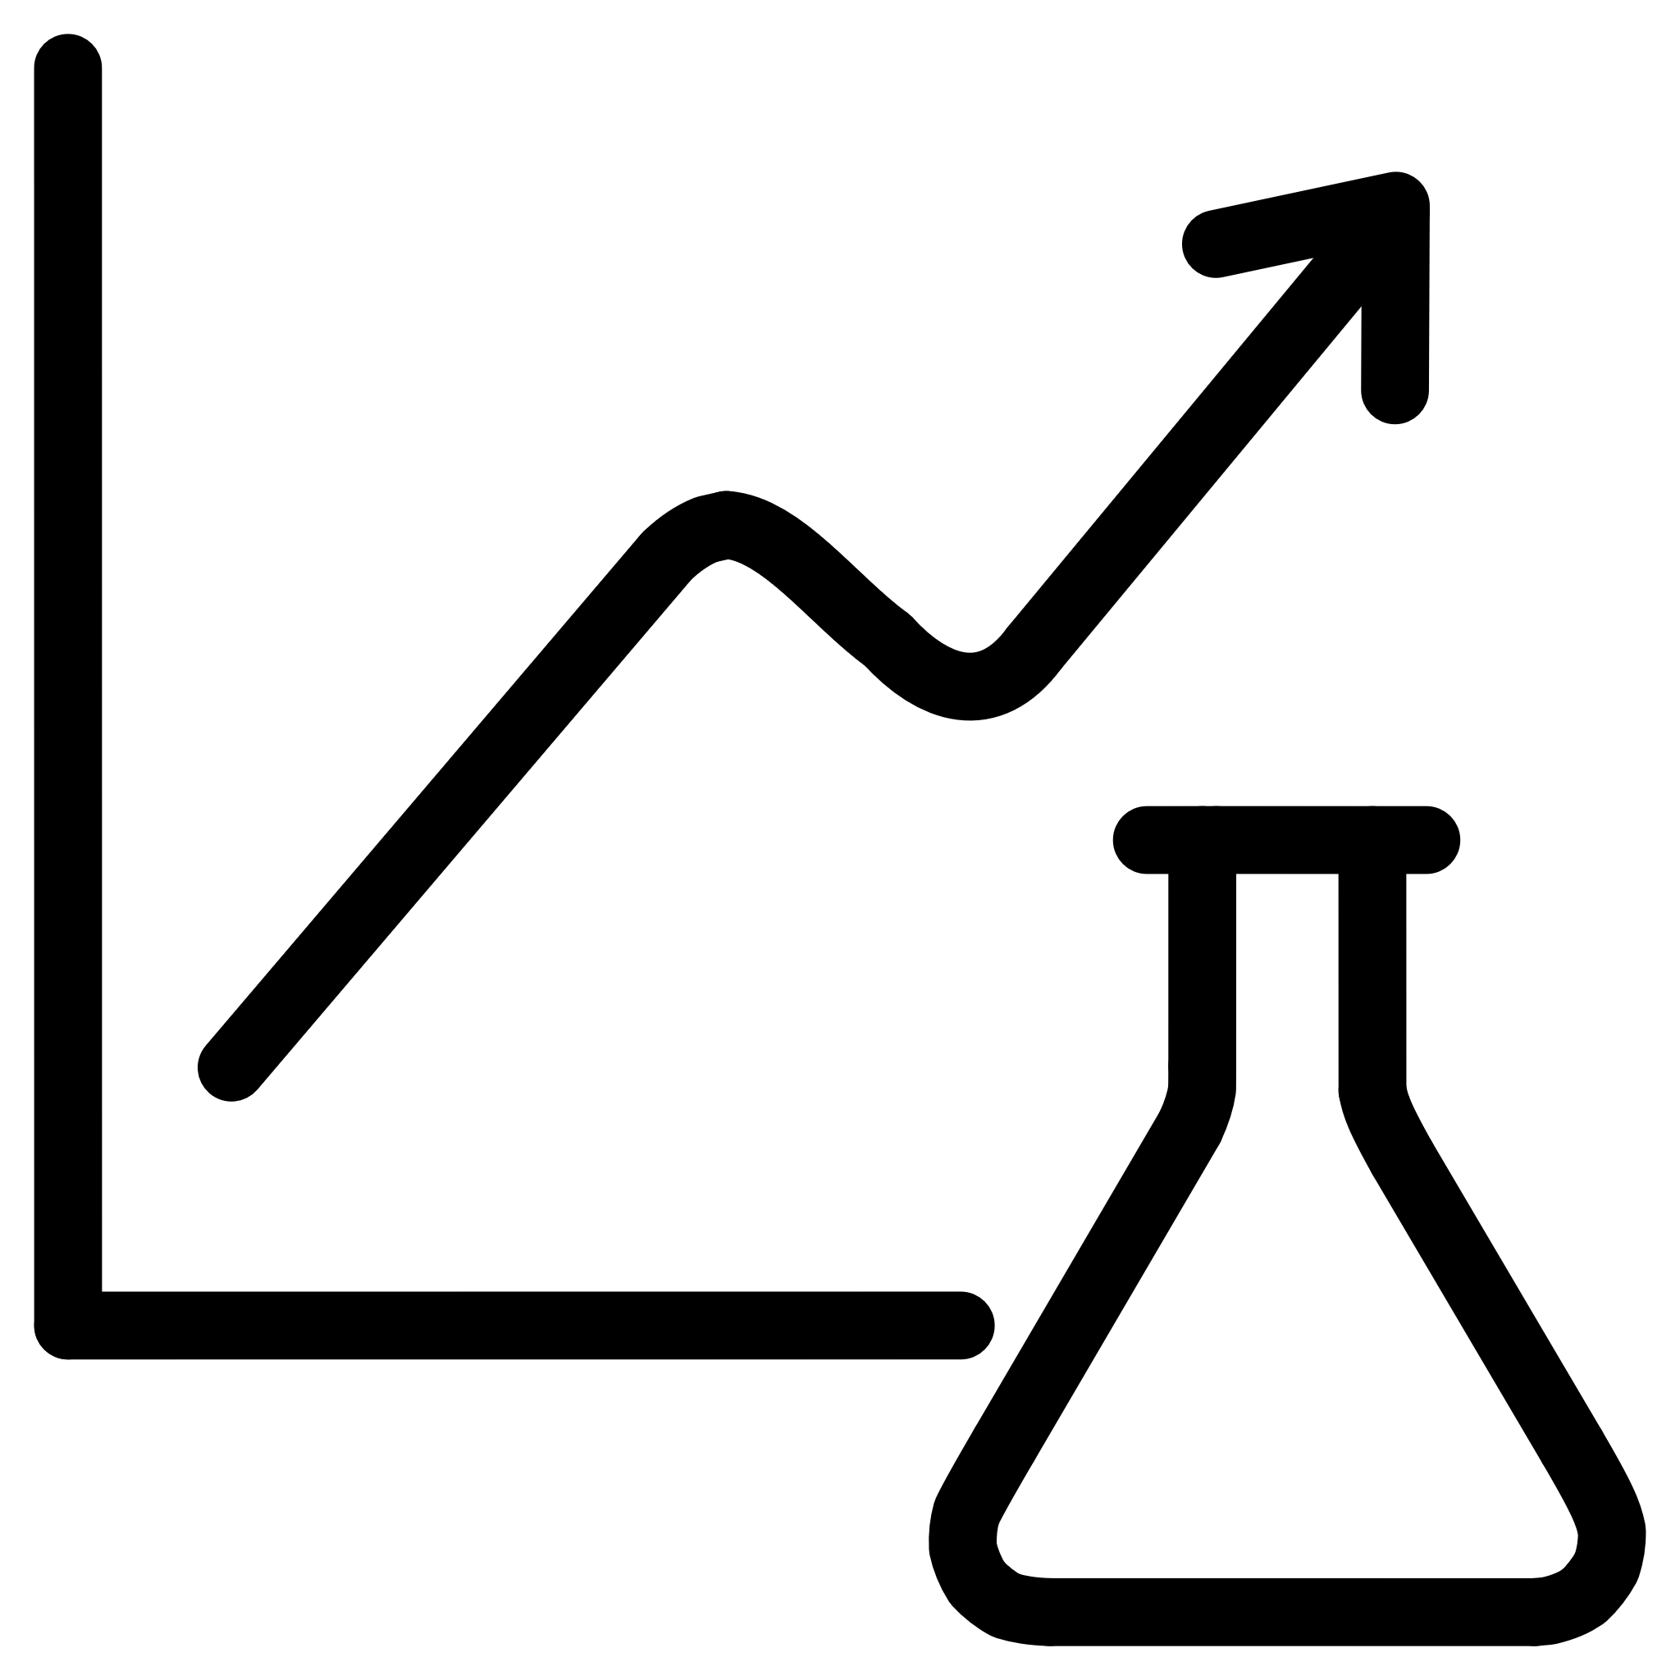
What is Pandas? A High-Level Overview of its Core Components
Data Structures
Data Manipulation
Analytical Tools
At its heart, Pandas introduces two primary data structures: Series and DataFrame. A Series is a one-dimensional labeled array capable of holding any data type, similar to a column in a spreadsheet or a SQL table. A DataFrame is a two-dimensional labeled data structure with columns of potentially different types, much like a spreadsheet or a database table.
Pandas provides powerful tools for manipulating data, including indexing, selecting, filtering, merging, and reshaping. These operations enable efficient data preparation for analysis, making complex transformations straightforward and intuitive.
Beyond manipulation, Pandas integrates seamlessly with other Python libraries like NumPy and Matplotlib, offering robust functionalities for statistical analysis, time-series operations, and data visualization. This makes it an indispensable tool for data scientists and analysts.

Slide 4

Importing and Exploring Data: Getting Started with DataFrames
Loading Your Data
The first step in any data analysis project is loading your data. Pandas supports a wide range of file formats, including CSV, Excel, SQL databases, and JSON. The pd.read_csv() and pd.read_excel() functions are commonly used for this purpose, quickly transforming raw data into accessible DataFrames.
Initial Data Exploration
Once loaded, it's crucial to get a quick overview of your dataset. Methods like .head(), .tail(), .info(), and .describe() offer insights into the data's structure, missing values, data types, and basic statistical summary. This initial exploration helps in identifying potential issues and understanding the data's characteristics.
"Data in its raw form is like unpolished gem; it needs to be cleaned and shaped before its true value can be appreciated."

Slide 5
Data Cleaning and Preprocessing: Taming Messy Datasets
Raw data often comes with imperfections. Pandas provides a comprehensive suite of tools to handle these challenges, ensuring your data is ready for accurate analysis.
Handling Missing Values
Removing Duplicates
Missing data can skew results. Pandas offers methods like .isnull(), .dropna(), and .fillna() to detect and manage missing entries, allowing you to either remove them or impute values based on various strategies.
Duplicate records can lead to overrepresentation and incorrect analysis. The .duplicated() and .drop_duplicates() functions are essential for identifying and removing redundant rows.
Correcting Data Types
Renaming Columns
Ensuring correct data types is vital for appropriate operations. Pandas' .astype() method allows you to convert columns to the desired types, for instance, converting string representations of numbers to integers or floats.
Clear and concise column names improve readability and usability. The .rename() method provides an easy way to update column labels, making your DataFrame more intuitive.

Slide 6




Data Manipulation and Transformation: Reshaping Your Insights
Pandas excels at transforming and manipulating data to extract meaningful insights. These operations are critical for preparing data for advanced analysis or visualization.
Merging and Joining
Grouping and Aggregating
Combine multiple DataFrames based on common columns using pd.merge() or .join(), similar to SQL join operations. This allows you to integrate data from various sources.
Use .groupby() to group data by one or more columns and apply aggregate functions like .sum(), .mean(), .count(), or .max() to each group. This helps in summarizing large datasets.
Pivoting and Reshaping
Applying Functions
Reshape your DataFrames using .pivot_table(), .stack(), and .unstack() to change the orientation of your data, making it easier to analyze specific aspects or prepare for different visualization needs.
Execute custom functions across rows or columns using .apply() or .map(). This is incredibly flexible for performing complex, element-wise transformations.

Slide 7
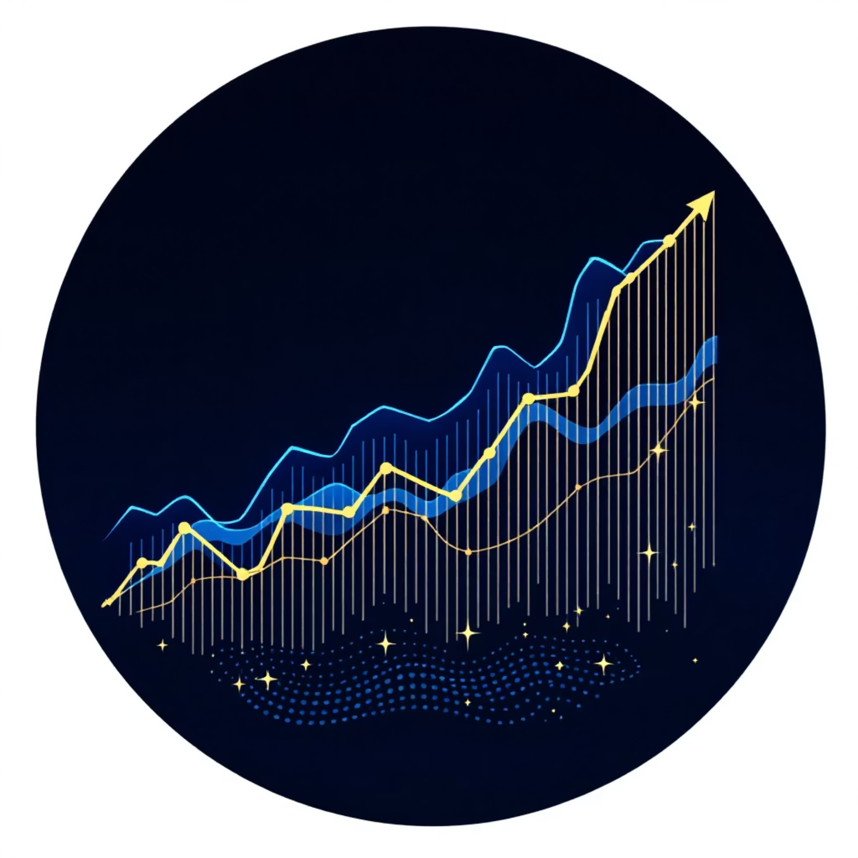

Time Series Analysis with Pandas: Unveiling Temporal Patterns
Pandas offers specialized functionalities for working with time-series data, making it an ideal tool for financial analysis, environmental monitoring, and forecasting.
Date and Time Indexing
Pandas' DatetimeIndex allows for powerful indexing and slicing of time-series data. This enables efficient selection of data based on dates, times, or specific date ranges.
Resampling and Frequency Conversion
The .resample() method is crucial for changing the frequency of time-series data, such as converting daily data to monthly or yearly averages, facilitating analysis at different granularities.
Time-based Operations
Perform calculations like rolling averages, cumulative sums, and time differences with ease. These operations are fundamental for identifying trends, seasonality, and other temporal patterns.
Understanding time-series data is critical for making informed predictions and uncovering hidden patterns in sequentially ordered observations.

Slide 8
Key Takeaways & Next Steps: Your Pandas Journey Continues
Master the Fundamentals
Explore Advanced Features
A solid grasp of DataFrames, Series, and basic operations is paramount. Practice importing, cleaning, and manipulating various datasets.
Dive deeper into .groupby(), merging, and time-series tools. These unlock more sophisticated analysis capabilities.
Integrate with Other Libraries
Continuous Learning
Combine Pandas with Matplotlib/Seaborn for visualization, and Scikit-learn for machine learning. This creates a powerful data science toolkit.
The Pandas ecosystem is vast and constantly evolving. Engage with the community and work on diverse projects to solidify your skills.
Your journey with Pandas is just beginning. By consistently applying these concepts and exploring new challenges, you'll become proficient in leveraging this incredible library for all your data analysis needs.

Slide 9


